Slide 1
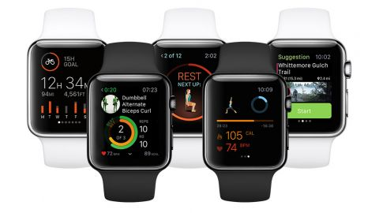
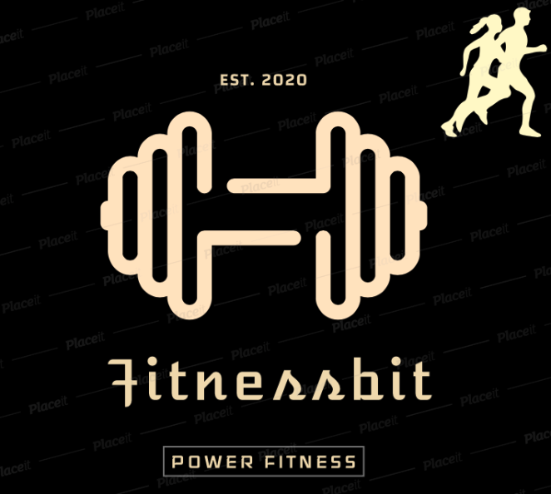
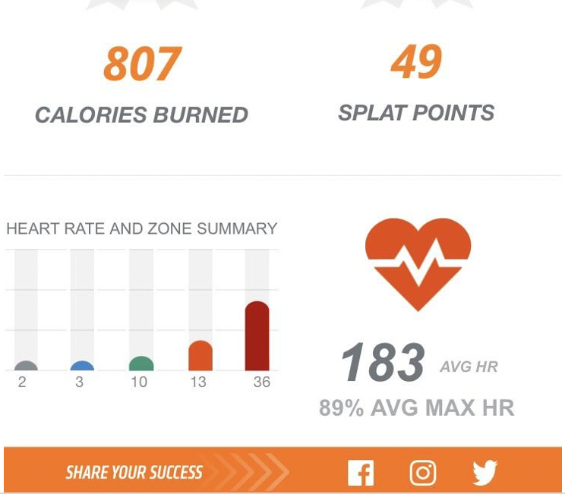
FITNESS BIT

Slide 2
Description
An App which will connect users to trainers, coaches, nutritional supplement vendors, fitness machine manufacturers
Bring Revolutionary change to fitness industry which will benefit everyone involved in the transaction
Develop our own Blockchain to store data from the Users application which can be any form of smart devices like smart phones, smart watches, fitness wearables and or any Internet of Thing technologies.
Flexibility of Sharing data in return for a reward (fitnessbit coins) which can be used to contribute towards their membership or buy any nutritional supplements or to purchase any accessories on the website

Slide 3
Problem
User data stored in smart devices are subject to hack/breach and hence the data must be kept private and secure , this is where the blockchain comes into picture
Trainers in the gym are subject to have their income deducted for the use of the gym facility as Studios take a percentage of Trainers revenue in exchange to the user of their studio
Not everyone is familiar with blockchain platform and therefore the predicted spike in demand at the moment is relatively low
Working out in gym packed with the crowd waiting for machines can be sometimes intimidating and most importantly can turn out expensive, besides your timetable may not fit the needs

Slide 4
Solution
With Blockchain Technology, fitness trainers and AI driven apps can let go brick-and-mortor studios that sell their services face to face to a consumer
The consumers are demanding content when they need it wherever they are located
Fitness bit will offer the instructor and the user to interact with each other online , this way the trainer can instruct or correct the user in real time if they were to perform any exercises incorrectly or unsafely
Fitnessbit ensures to only enroll licensed & certified Fitness Instructor who has a proper knowledge on conducting fitness training, this provides assurance to the user that they are in safe hands
Fitness bit gives you an opportunity to test out different programs from the comfort of your home with a certified and licensed fitness trainer

Slide 5
Customers
Individuals who are looking for Health & Training Remotely without stepping out of their home
Gym Members
Exercise Motivation/health Conscious
Data and Security Privacy
Sports Enthusiasts
Sponsors- personal trainers , sports clubs, Gym owners
Members who owns wearables
Service providers – Digital Products,, National Brands

Slide 6
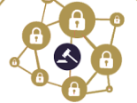
Products & Service
Gamification
Tier Status level
Immediate purchases
No intermediate approver
Gym Rewards Mining app
Decentralized data repository
Blockchain controlled by members to ensure security
Payment
Market place
Digital video , supplements, nutrition plans
Gym Studio Partnership
Mining
Data
Rewards Exchange
Earn Fitnessbit coins
Gym Equipments Manufacturer or
Supplement provider
GYM
Trading
Blockchain
Offers
Manufacturer
Workout
Trainers
Workout Plan
Powered by Artifcal Intelligence
Digital Health and Fitness Record
Trainers
Certified and licensed Trainers

Slide 7
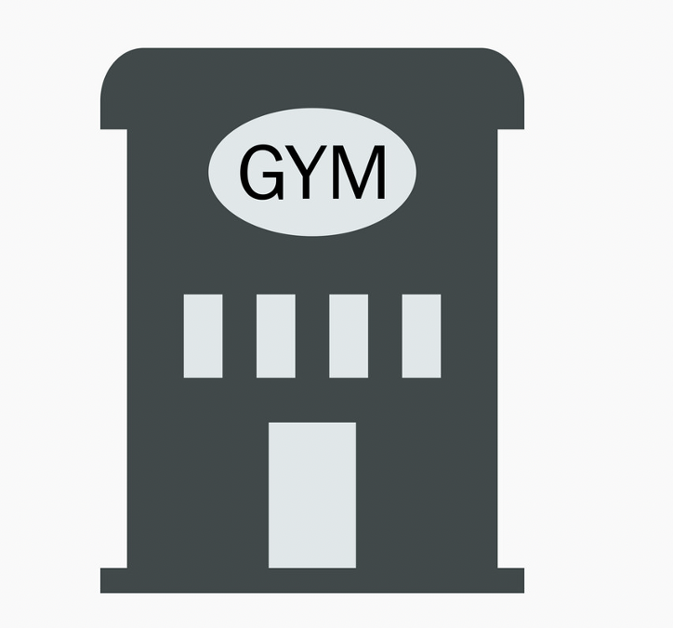

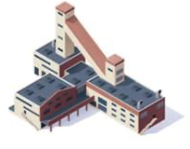
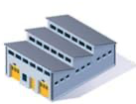
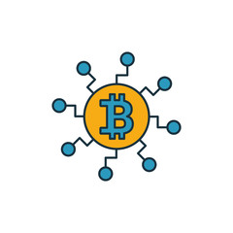
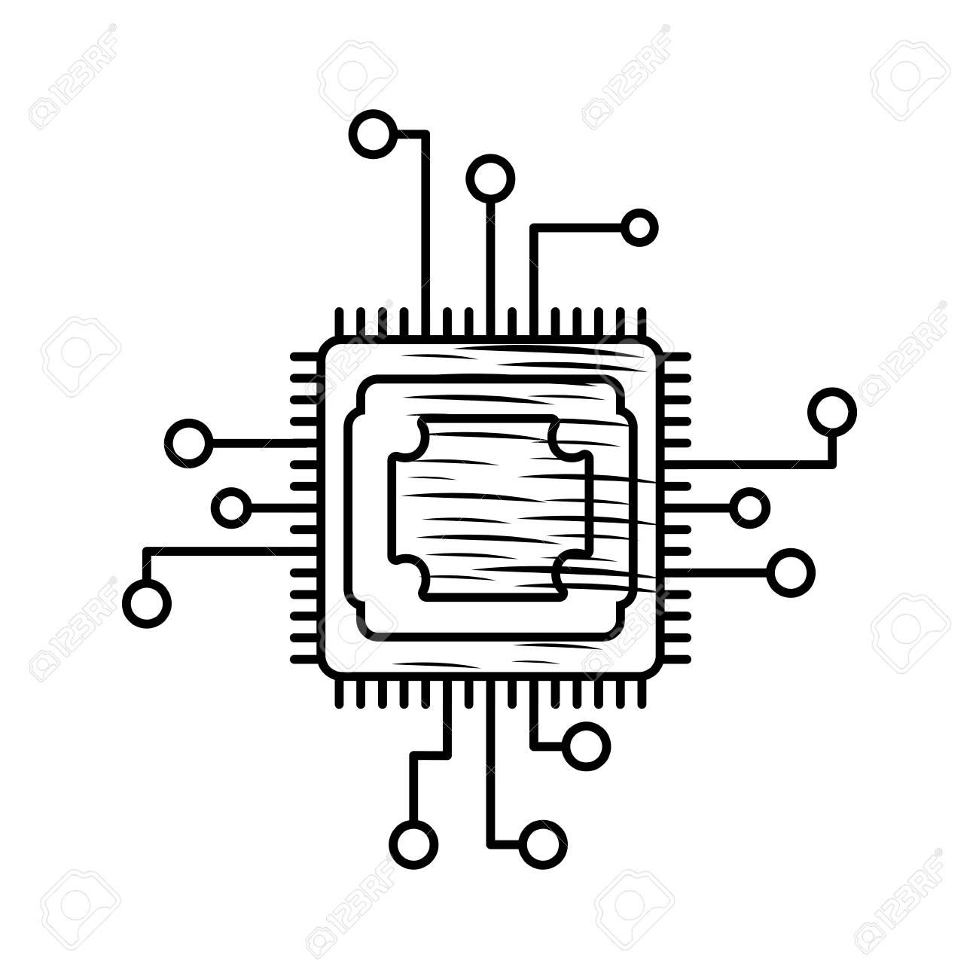
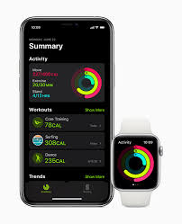
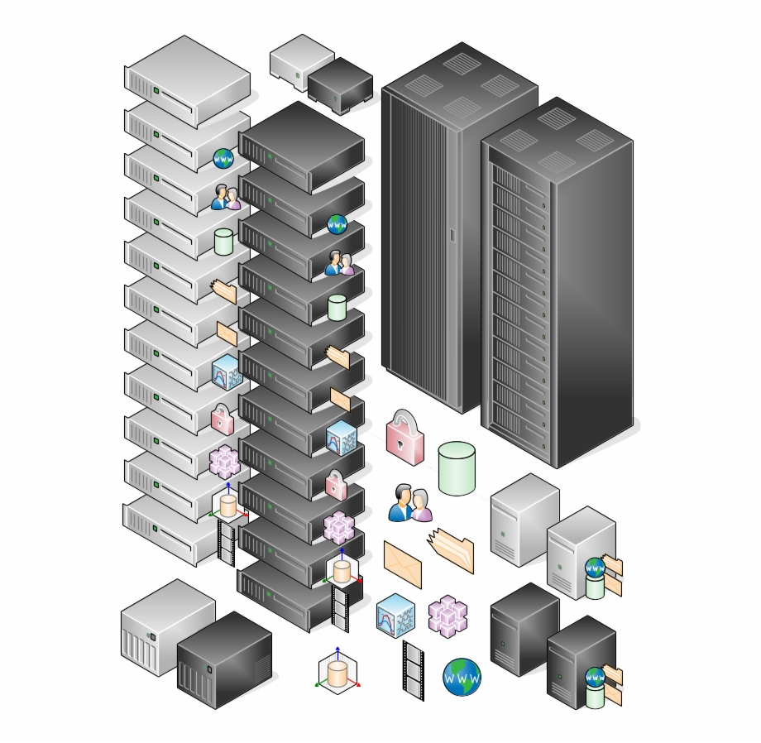

Technical Solution
Third Parties
Fitness machines manufacturers and Supplements
data
AI
Fitness bit Studios
Statistics
data
Statistics
Block Chain Node
User with Fitnessbit App
User private key
Fitness bit Core
Private key Storage

Slide 8
Team
Cryptocurrency Specialist
Infrastructure
Backends supporting
UI & UX
Marketing Consultants

Slide 9
Market Analysis
Security Platform
Cloud base
Sales & Marketing Strategy
Making system managements with Gyms and Manufacturers
Helping them to involve into the cloud base environment.
Advertising at the social media
Maintaining the network and stable clouds.

Slide 10
BlockData
Customers:
Basic data ( Age, Sex, Height and Weight)
Exercise data (Time, Sets, Actions)
Heart Rate
Oxygen saturation
Training Program
Trainers/Coaches:
Professional major
Training program
Manufacturer/Supplement
Training equipment
Protein Powder
Diet meals

Slide 11
BlockData
Training program
Title
Trainer
Trainee
Time
Tokens
Contract
Items
Customer / Trainer
Manufacturer / Supplement
Shipment info

Slide 12
Data Privacy and Security
In contrast to extensive use of smartphones , fitness and health applications, it has become most eminent to track daily workouts, calories burnt, keeping a track of workout routines etc
Fitnessbit is built on an encrypted blockchain network that activates privacy and security with each and every transaction
We offer a strong privacy policy i.e, 100% GDPR complaint
As all the data is stored on Blockchain Network, Fitnessbit will not store any user data and hence users will have full priv/control over their health information
Fitnessbit also prohibits the sale of User data to any third party

Slide 13
Funding Strategy
Hedge fund
Banks

